Slide 1
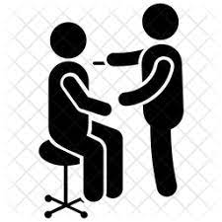
Importance of Annual Medical Tests
Dr. Chioma Maduoma
Consultant Family Physician, Maitama District Hospital
Supervising Consultant, FIRS Staff Clinic Abuja

Slide 2
Outline
Introduction
Why do the tests
Tests for all adults
Tests for men
Tests for women
Conclusion – ABCDE of healthy behaviours

Slide 3
Introduction
Annual medical tests are physical examinations and tests done yearly
They can also be done at more less frequent periods
They are important to your overall health and well-being
Knowing what to expect can make the entire experience easier and more comfortable.
It is Preventive Medicine…. ‘Prevention is better than cure’

Slide 4
Do I really want to know?

Slide 5
What I don’t know won’t harm me, right ? So, really, why bother?

Slide 6
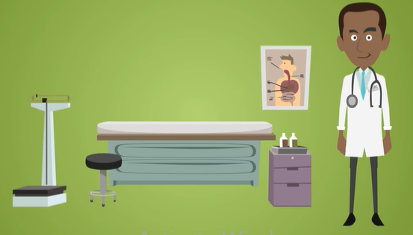
How does it help, if I know?
Those who already have these conditions can learn to cope with and control them to have a better quality of life.
As people identify their potential risks through testing, they can be encouraged to modify their lifestyle to a healthy one.

Slide 7
Risk factors for non communicable diseases/ conditions
The risk factors that cannot be changed or controlled
Race
Family History
Gender
Age

Slide 8
Risk factors for non communicable disease
4 by 4 framework
Risk factors that that can be controlled

Slide 9
Annual Screening promotes healthy behaviour as the risks are identified. Hence the disease can be prevented.

Slide 10
Two types of tests: Screening Tests Vs Diagnostic Tests
Screening tests are done on supposedly healthy people in order to know as early as possible, whether or not they have an illness or disease.
Diagnostic tests are used to confirm or refute the existence of disease.
Tests can be based on gender, age group and job description

Slide 11
Tests to do for ALL adults
What to screen | Example of test | Type of diseases being screened for
Kidney | Electrolytes , Urea and Creatinine | Chronic kidney disease
Heart | Electrocardiogram & Echocardiography | Heart enlargement, Heart attack, Heart failure, Heart damage
Heart and Lungs | Chest X-ray | Heart disease, Tuberculosis
Liver | Liver Function Tests including Hepatitis B and C screening. | Hepatitis which can lead to liver cancer
Blood vessels | Fasting Lipid profile | Metabolic syndrome which can lead to heart disease, diabetes, peripheral artery disease and stroke.
 | Blood Pressure measurement | Hypertension which can lead to kidney disease, heart disease and stroke

Slide 12
Tests to do for ALL adults
What to screen | Example of test | Type of diseases being screened for
Weight and Height | Body Mass Index assessment | Obesity
Ear | Ear, Nose and Throat Examination | Screening for Deafness
Eye | Refraction, Intraocular pressure and glaucoma screening | Visual problems and prevention of blindness from glaucoma, cataract, diabetes
Blood | Full blood Count | Anaemias, Infections and blood cancers
Blood glucose | HBA1C , FBS | Diabetes which can lead to stroke and multiple organ damage
Heart and Lungs | Chest X-ray | Heart disease, Tuberculosis

Slide 13
The Tests to do for MEN ONLY.
What to screen | Example of test | Type of diseases being screened for
Prostate | Prostate specific Antigen | Prostate cancer
 | Ultrasound of Liver, Kidney, Ureter, bladder and prostate | Liver Disease, Kidney Disease, Prostate Cancer
Colorectal screening | Fecal occult blood test Flexible sigmoidoscopy, Colonoscopy | Colon Cancer

Slide 14
Tests to do for WOMEN ONLY
What to screen | Example of test | Type of disease being screened for
Cervix | Liquid based cytology + Human Papilloma Virus test | Cervical Cancer
Liver, Kidney, Ureter, bladder and pelvis | Abdomino-pelvic Ultrasound scan | Liver Disease, Kidney Disease Disease of the Female reproductive system
Breast | Breast Scan | Breast Cancer
 | Mammography | Breast Cancer
Colorectal screening | Fecal occult blood test annually; Flexible sigmoidoscopy, Colonoscopy | Colon Cancer

Slide 15
Common Cancers
Prostate cancer ( MEN)
Breast Cancer (WOMEN)
Start screening from the age of 50yrs
Risk factors include those with
Family history of Prostate cancer
High testosterone levels
Black race
Start screening from the age 40yrs
Risk factors include those with
Family history of breast cancer in either male or female relatives
Caucasian and black race

Slide 16
Lets Calculate our BMI
Body Mass Index(BMI) is a simple calculation using a person’s height and weight. The formula is
BMI (Kg/m2) = Weight (kg)
Height (m2)
Underweight <18.5 | Normal weight 18.5 – 24.9 | Overweight 25 – 29.9 | Obesity (Class I) 30- 34.9 | Obesity ( Class II) 35- 39.9 | Obesity ( Class III) ≥ 40
Notes:
BMI not adequate for muscle builders, long distance athletes, pregnant women, the elderly or young children.
This is because BMI does not take into account whether the weight is carried as muscle or fat, just the number.

Slide 17
Step by Step Approach to Annual Medical Tests
Visit the clinic
Individual risk assessment
Schedule and do the tests
Get Interpretation of the results
Counselling and Education

Slide 18
ABCDE of Healthy Behaviours

Slide 19
IN SUMMARY

